Slide 1

Types of data and pandas operations
Session 2
May 22, 2021

Slide 2
AGENDA
Types of Data
Forms of Data
Pandas Operations

Slide 3
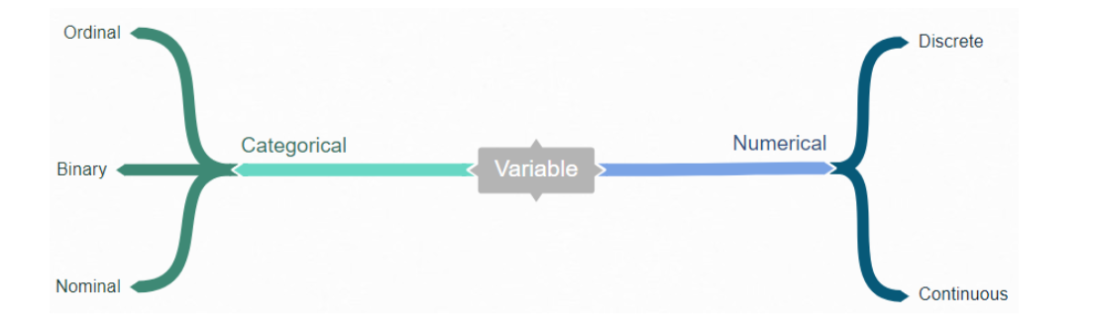
Types of data
Qualitative
Quantitative

Slide 4

Categorical - Binary
Only two possible values for this
Eg,
Male or Female
True or False
Yes or No

Slide 5
Categorical - Nominal
This includes country name, religion,Marital status
Eg,
India
Pakistan
Afganistan

Slide 6
Categorical - Ordinal
This includes the ranking data which has the value based on the ranking order
Eg,
Priority of the bug
High
Medium
Low
Critical

Slide 7
Numerical
Numerical data is information that is measurable, and it is, of course, data represented as numbers and not words or text.
Continuous Data are the ones with no boundaries
Eg, height, Distance
Discrete Data are the ones we can count
Eg, amount, count of anything

Slide 8
Forms of data
Structured
Includes tables, arrays and vectors with proper structure
Eg, Database tables
Unstructured
Includes texts, images, and other unstructured Data
Eg, Resume of the person which has free flow text and Image
Semi Structured
There will be no definite structure but there will be classes with attributes
Eg, JSON, XML

Slide 9
PANDAS
Pandas is used in
Extract
Clean
Transform
Analyse
the data.

Slide 10
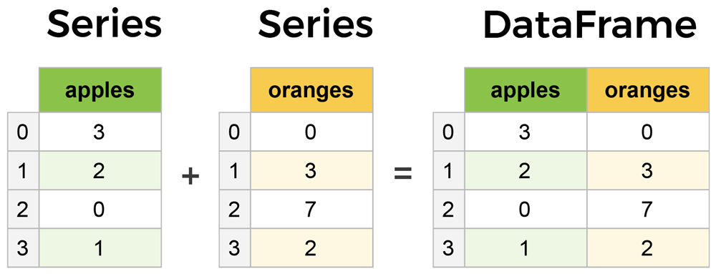
Pandas – DATAFRAME
Before going to pandas we need to understand what is dataframe in pandas.
2 or multi dimensional labelled data
Like excel or table
“Jupyter notebook hands on”

Slide 11
PANDAS – Data extraction
We can read data from
CSV
Excel
JSON
HTML
etc

Slide 12
Pandas operations
There are n number of pandas operations, but essentially
Viewing the Data
Head
Tail
Info about the Data
Info
Shape
Handling Duplicates
Handling null values
Column Cleanup

